Slide 1
Chapter 26

Slide 2
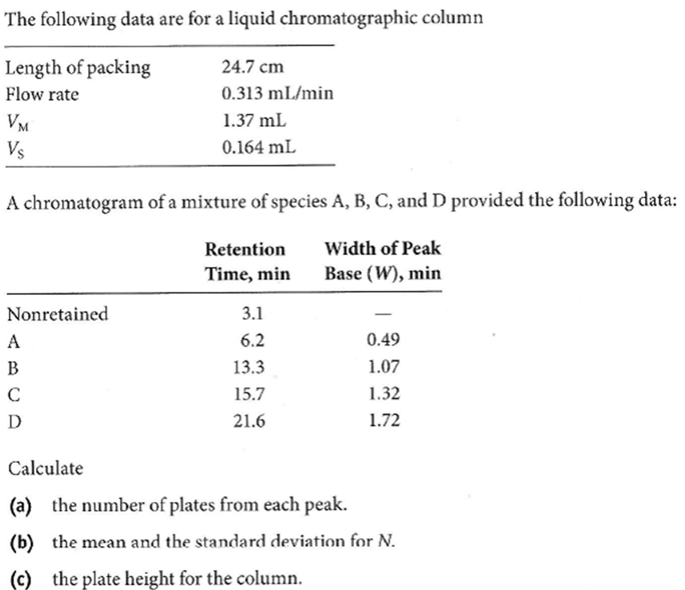
26-14
N= 16(t_{R}/W)² (Equation 26-21)
For A, N= 16×(6.2/0.49)²=2561.6 or 2562 For B, N= 16×(13.3/1.07)²=2472.04 or 2472 For C, N= 16×(15.7/1.32)²=2263.45 or 2263 For D, N= 16×(21.6/1.72)²=2523.31 or 2523
N= (2561.6 + 2472.04 + 2263.45+2523.31)/4 =2455.1or 2455; s=132rounded to 100
H=L/N(Equation 26-16 rearranged) H= 24.7 cm/ 2455plates =0.01006 cm (round to 0.010cm)

Slide 3
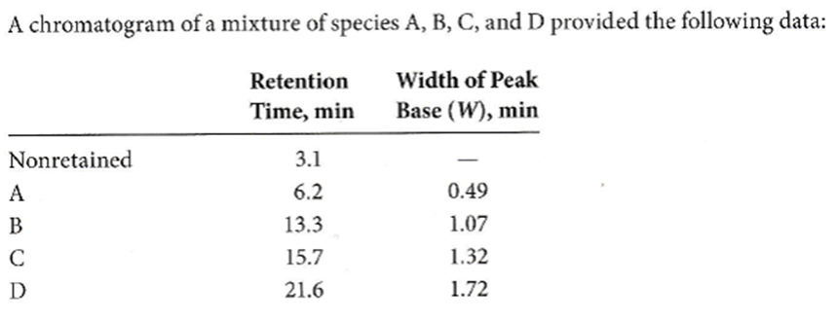
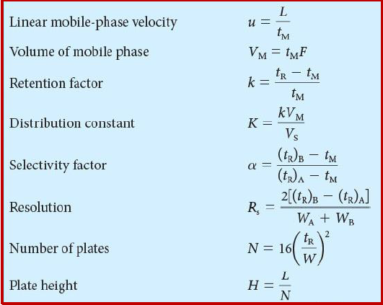
26-15
From the data in Problem 26-14,
calculate for A, B, C, and D
The retention factor.
The distribution constant.
k= (t_{R}–t_{M})/t_{M}(Equation 26-12) For A, k_{A}= (6.2–3.1)/3.1 =1.0 For B, k_{B}= (13.3–3.1)/3.1 = 3.3 For C, k_{C}= (15.7–3.1)/3.1 =4.1 For D, k_{D}= (21.6–3.1)/3.1 = 6.0
K=k(V_{M}/V_{S}) K= [(tR–tM)/tM]×8.35 KA= 1×8.35=8.4 KB= 3.3×8.35 = 27 KC= 4.1×8.35 = 34 KD= 6.0×8.35 = 50

Slide 4
Chapter 27

Slide 5
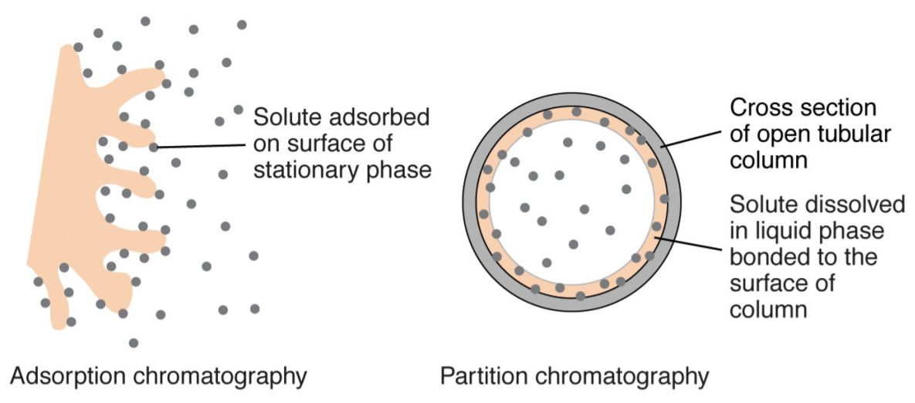
27-1
How do gas-liquid and gas-solid chromatography differ?
In gas-liquid chromatography(GLC), the stationary phase is a liquid that is immobilized on a solid. Retention of sample constituents involves equilibria between a gaseous and a liquid phase. In gas-solid chromatography(GSC), the stationary phase is a solid surface that retains analytes by physical adsorption. Here separations involve adsorption/desorption equilibria
在氣液色譜法中，固定相是固定在固體上的液體。樣品成分的保留涉及氣相和液相之間的平衡。
在氣固色譜中，固定相是通過物理吸附保留分析物的固體表面，分離涉及吸附/解吸平衡
GSC
GLC
https://chem.pg.edu.pl/documents/175289/4235082/AP-Part2.pdf

Slide 6
27-3
What is meant by temperature programming in GC?
Why is it frequently used?
Temperature programming involves increasing the temperature of a GC column as a function of time.
This technique is particularly useful for samples that contain constituents whose boiling points differ significantly. Low boiling point constituents are separated initially at temperatures that provide good resolution.
As the separation proceeds, the column temperature is increased so that the higher boiling constituents come off the column with good resolution and at reasonable lengths of time.
溫度編程涉及隨時間增加GC管柱的溫度。
對於包含沸點明顯不同的成分的樣品，此技術特別有用。 低沸點成分最初是在提供良好分離度的溫度下分離的。
隨著分離的進行，色譜柱溫度升高，因此沸點較高的組分以良好的分離度和合理的時間從管柱中分離出來。

Slide 7
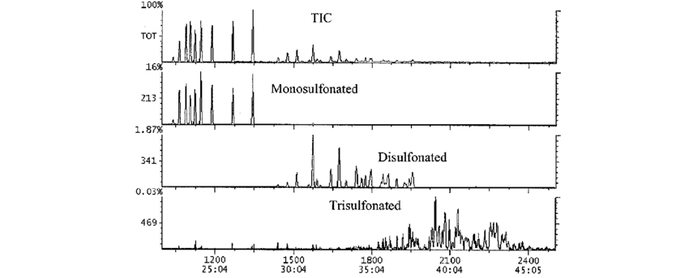
27-8
What is the difference between a total-ion chromatogram and a mass chromatogram?
A total ion chromatogram is obtained by summing the ion abundances in each mass spectrum and plotting versus time.
A mass chromatogram is obtained by monitoring one m/z value during the chromatography experiment and plotting the ion abundance versus time.
通過將每個質譜圖中的總離子豐度相加並繪製時間圖，可獲得總離子色譜圖。
通過在色譜實驗期間監視一個m / z值並繪製離子豐度與時間的關係圖，可獲得質譜圖。
Cohen et al., J. SURFACTANTS DETERG., 2003, 6

Slide 8
27-9
Discuss why the combination of GC and mass spectrometry is so powerful?
The combination of GC with MS allows the identification of species eluting from the chromatographic column.
The total ion chromatogram gives information similar to a conventional GC chromatogram.
By monitoring selected ions, information about specific species can be obtained.
By scanning the mass spectrum during the chromatography experiment, species eluting at various times can be identified.
Gas chromatography coupled with tandem mass spectrometry allows even more specific identifications to be made.
GC與MS的結合可鑑定從管柱上洗脫的物質。
總離子流色譜圖提供的信息類似於常規GC色譜圖。
通過監視選定的離子，可以獲得有關特定物種的信息。
通過在色譜實驗中掃描質譜，可以確定在不同時間洗脫的物質。
氣相色譜與串聯質譜聯用可進行更具體的鑑定。

Slide 9
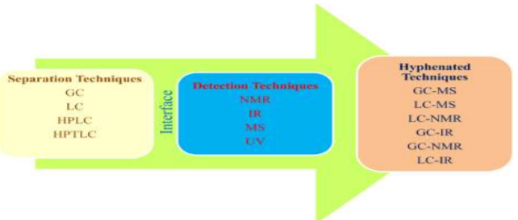
27-10
What are hyphenated GC methods? Briefly describe two hyphenated methods
Hyphenated methods couple GC with a different instrumental technique such as mass spectrometry, FTIR, NMR spectroscopy, or electrochemical methods.
The effluent from the GC column is either continuously monitored by the second technique or collected and measured.
聯用方法將GC與其他儀器技術（例如質譜法，FTIR，NMR光譜法或電化學方法）結合使用。
來自氣相色譜柱的流出物通過第二種技術連續監測或收集和測量。
Rageeb et al., Sch. Acad. J. Pharm., 2017; 6, 263-272

Slide 10

Question 27-11
What is the packing material used in most packed GC columns?
Answer:
通常使用直徑介於250-170 µm或170-149 µm之間的矽藻土(diatomaceous earth particle)做為填充材料
GC columns 可由不銹鋼、聚四氯乙烯(鐵氟龍)、玻璃、銅等製成。
不鏽鋼製成的管柱:機械強度佳、耐腐蝕、在高溫下操作對大部分物質無催化作用。
GC columns 種類:
填充管柱(packed column)
內徑介於2-4 mm，將固定相塗布包覆在載體(support)上，再填入玻璃管或不銹鋼管中使用
(影響效率可能原因：柱前壓力大、填料填太緊、流速慢)
毛細管柱(Capillary column、Open tubular capillary column)
多由不銹鋼管柱拉製成螺旋型，柱內徑為0.1-0.5 mm，柱長30-300 m
滲透率高、柱阻抗小，適合用於快速分析
e.g. SCOT, WCOT
Packed column
Capillary column
http://chs.ctust.edu.tw/ezfiles/20/1020/attach/20/pta_6325_6302205_39308.pdf

Slide 11
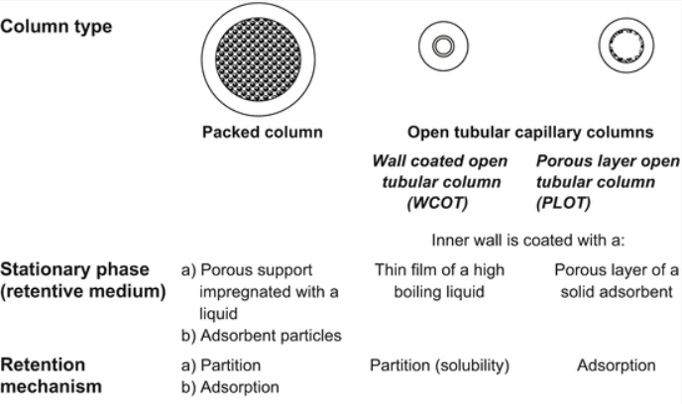
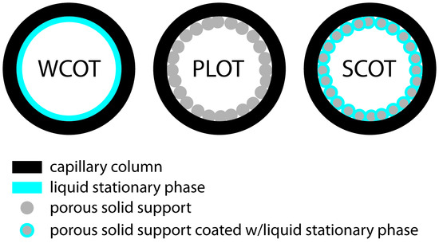
Question 27-12
How do the following open tubular columns differ?
A) PLOT B)WCOT C)SCOT
PLOT =porous layer open tubular column
PLOT column 的內側有一層薄膜，例如矽藻土。
SCOT=support coated open tubular column
是先將載體(support)（多用矽藻土）黏在玻璃管内壁上,加熱拉製成毛细管,再塗上固定液(liquid stationary phase)。
WCOT=wall coated open tubular
由熔融石英，不銹鋼，鋁，銅，塑料或玻璃製成的毛細管。 它的內壁塗有流動相(liquid stationary phase)的薄層。
Engewald, W., et al. Practical Gas Chromatography. 2014. 59-116.

Slide 12
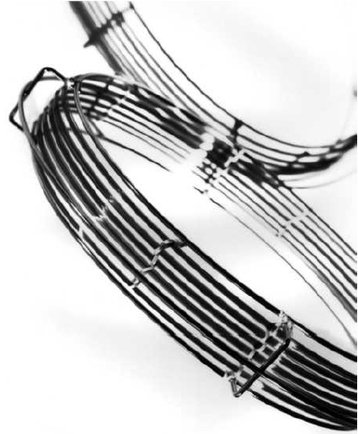
Question 27-14
What are the advantages of fused-silica capillary columns compared with glass or metal columns?
熔融石英柱比玻璃空心管柱具有更高的物理強度(greater physical strength)和柔韌性(flexibility)，比玻璃或金屬管柱對分析物的反應性更低(less reactive )。
課本 p.704 (fused-silica capillary columns)
fused-silica capillary columns

Slide 13
Question 27-15
What properties should the stationary phase liquid for GC possess?
GC固定相的理想特性包括：
低揮發性(low volatility)
熱穩定性(thermal stability)
化學惰性(chemical inertness)和溶劑特性(solvent characteristics )，可為要分離的分析物提供合適的k（平衡常數）和α（解離度）值。

Slide 14
Question 27-16
What is the effect of stationary-phase film thickness on gas chromatograms?
膜的厚度會影響分析物通過column的速度，並且隨著膜厚的減小而增加。

Slide 15
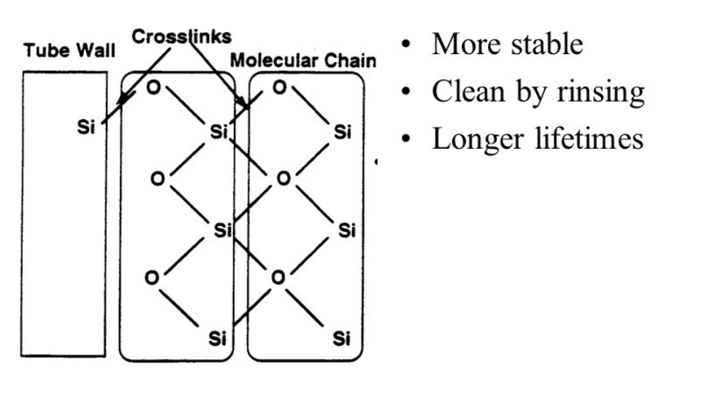
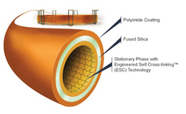
Question 27-17
Why are gas chromatographic stationary phase often bonded and cross-linked? What do these terms mean?
液態固定相通常鍵結或交聯(cross-linked)，以提供熱穩定性和更永久的固定相。
鍵結(bonded)
通過化學鍵將固定相的單分子層附著到填料表面。
交聯(cross-linked)
化學固定相在column中時用化學試劑處理，該化學試劑在構成固定相分子之 間產生交聯。

Slide 16
Question 27-18
List the variables that lead to (a)band broadening (b)band separation in GLC
（a） Band broadening是由過高或過低的流速(flow rates )，大尺寸的填料，固定相的厚度，低注射速率(injection rates)引起的。
（b）使用小顆粒進行填充，限制固定相的數量(薄層)，快速進樣，有助於band separation 。

Slide 17
Question 27-20
The same polar compound is gas chromatographed on an SE-30 (very nonpolar) column and then on a Carbowax 20M (very polar column).
How will K=C_{s}/C_{m} vary between the two columns?
The distribution coefficient for a polar compound will be larger on the carbowax 20M column than on the nonpolar SE-30 column

Slide 18

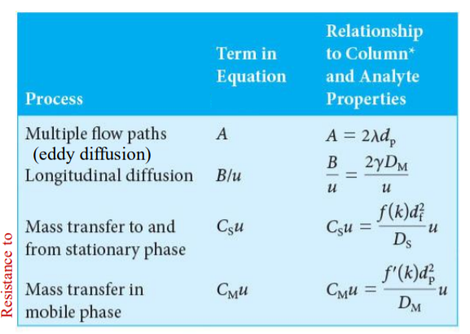
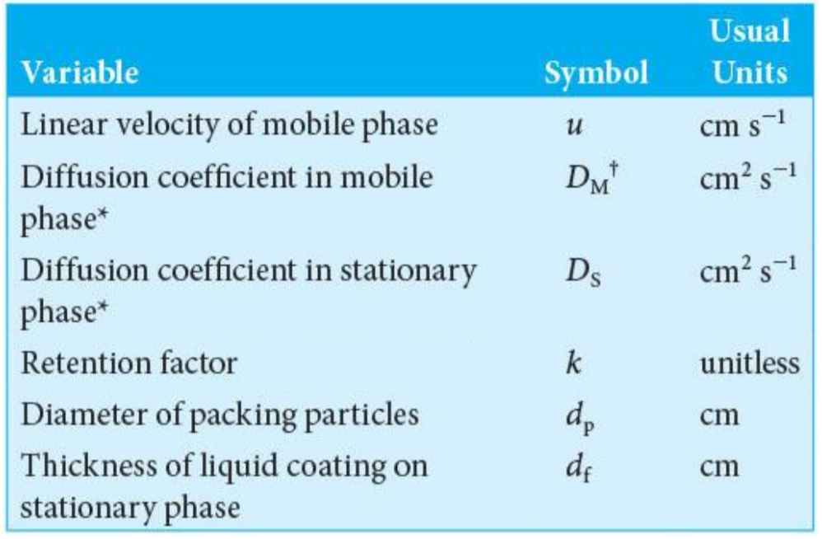
Question 27-27
What would be the effect of the following on the plate height of a column? Explain.
Increasing the mass of the stationary phase relative to the packing mass.
Decreasing the rate of sample injection.
Increasing the injection port temperature.
Increasing the flow rate.
Reducing the particle size of the packing.
Decreasing the column temperature.

Slide 19
Question 27-27
Increasing the mass of the stationary phase relative to the packing mass.
V_{S}/V_{M} ↑, film thickness d_{f}↑, C_{S}↑ , H↑
Decreasing the rate of sample injection.
Reducing the rate of sample injection will lead to band broadening because all the molecules do not start to traverse the column at the same instant. Reduced efficiency and an increase in H results.
Increasing the injection port temperature.
Increasing the injection port temperature will tend to decrease H because the evaporation rate will increase. Thus, the sample will be put on the column in a narrowband with less initial zone spreading.

Slide 20
Question 27-27
Increasing the flow rate.
Either increasing or decreasing H is possible.
Reducing the particle size of the packing.
D_{f} ↓ , C_{s}↓ , H↓
Decreasing the column temperature.
diffusion rates D_{M} and D_{S} ↓ , B ↓ , C_{s} ↑ , C_{M} ↑
Either increasing or decreasing H is possible.
Usually, H ↑

Slide 21
Question 27-28
What kinds of mixtures are separated by GSC?
Gas-solid chromatography is used primarily for separating low molecular mass gaseous species such as carbon dioxide, carbon monoxide and oxides of nitrogen
Question 27-29
Why is GSC not used nearly as extensively as GLC?
Gas-solid chromatography has limited application because active or polar compounds are retained more or less permanently on the stationary phase. In addition, severe tailing is often observed due to the nonlinear characteristics of the physical adsorption process.
GSC 使用固態靜相，其分配過程涉及物理吸附，對樣品的吸引力強，使極性大的氣體在靜相中成半永久性吸附或使波峰嚴重拉長，故僅使用於極性較小、低分子量、揮發性高的氣體

